Slide 1


Animation
Class 7
Lab 22

Slide 2

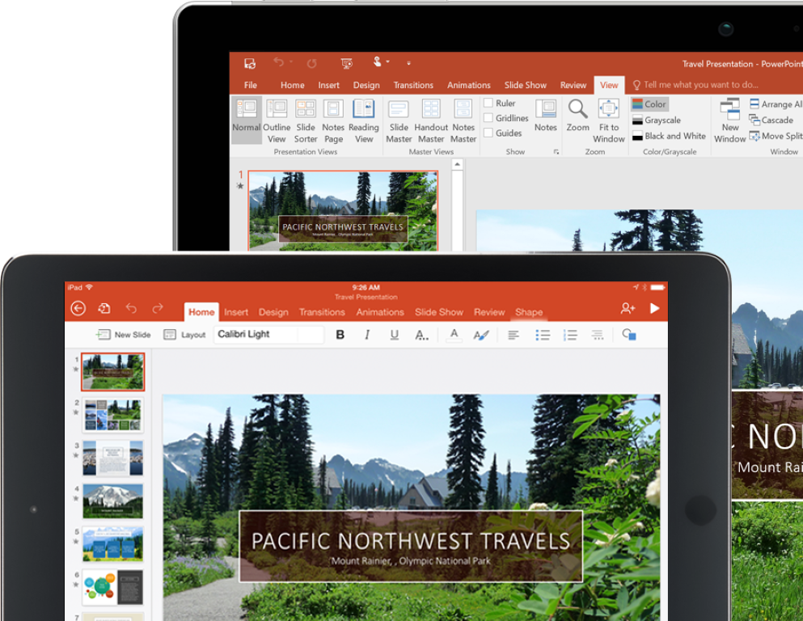
Microsoft PowerPoint
MS PowerPoint is a presentation slide making tool
Notes:
Notes to presenter:
Description of what you learned in your own words on one side.
Include information about the topic
Details about the topic will also be helpful here.
Tell the story of your learning experience. Just like a story there should always be a beginning, middle and an end.
On the other side, you can add a graphic that provides evidence of what you learned.
Feel free to use more than one slide to reflect upon your process. It also helps to add some video of your process.

Slide 3
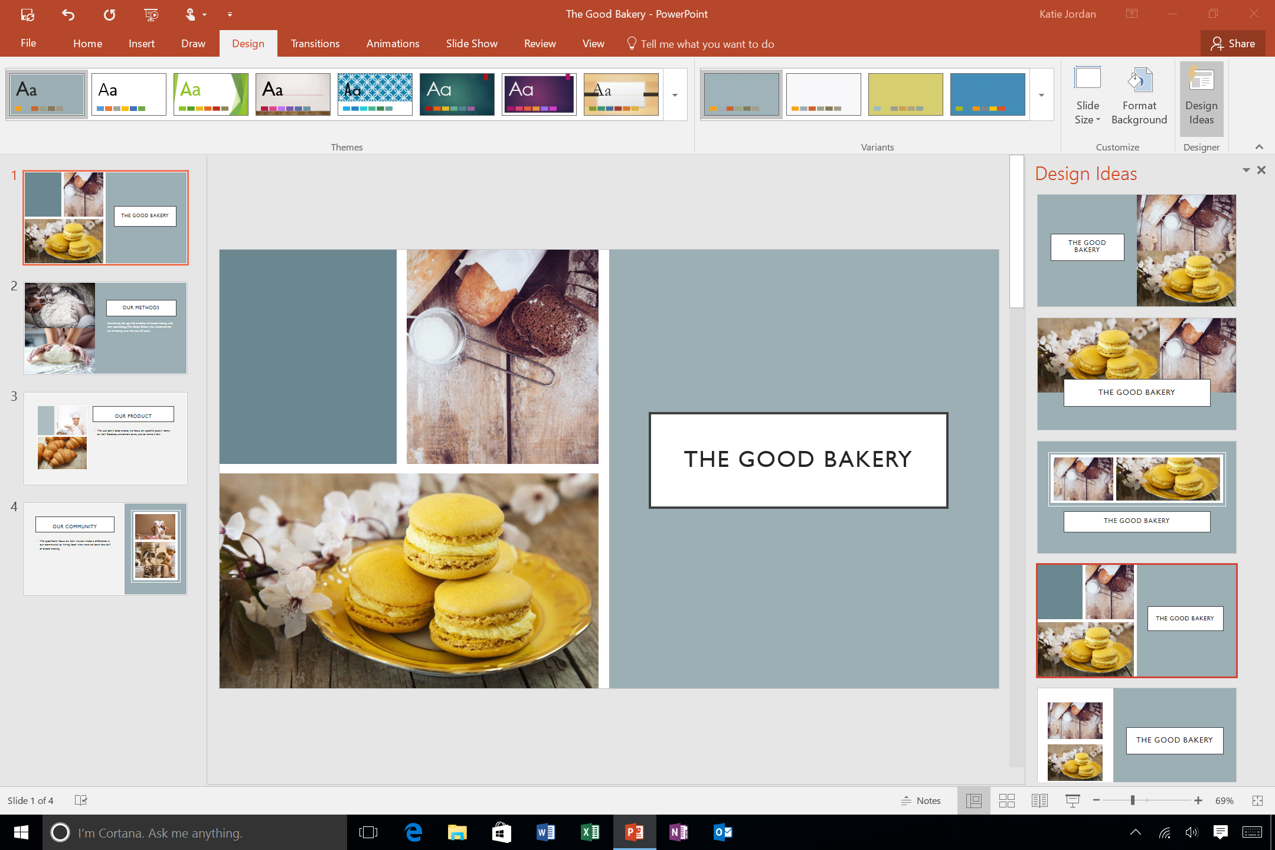
Microsoft PowerPoint
Previously we
used it for poster
designing
Notes:
Notes to presenter:
Description of what you learned in your own words on one side.
Include information about the topic
Details about the topic will also be helpful here.
Tell the story of your learning experience. Just like a story there should always be a beginning, middle and an end.
On the other side, you can add a graphic that provides evidence of what you learned.
Feel free to use more than one slide to reflect upon your process. It also helps to add some video of your process.

Slide 4
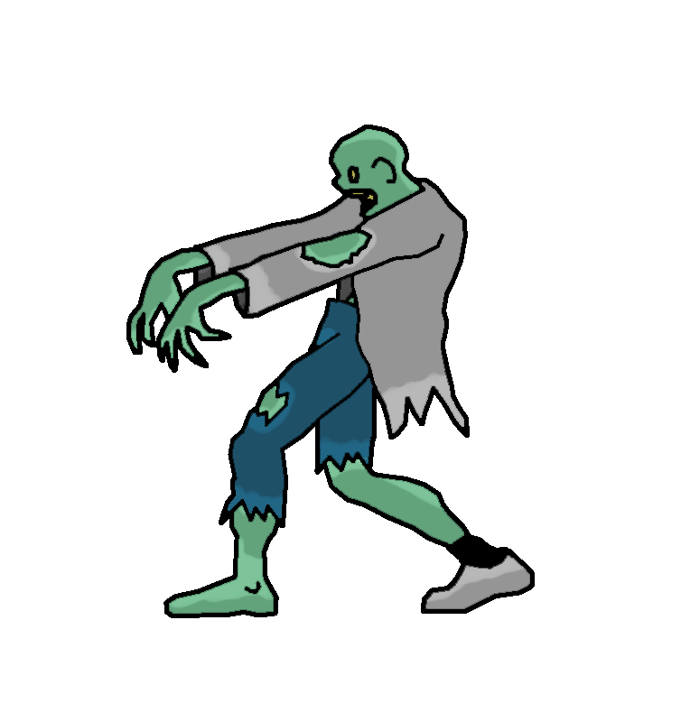
Microsoft PowerPoint
Today we will create animation using PowerPoint
Notes:
Notes to presenter:
Description of what you learned in your own words on one side.
Include information about the topic
Details about the topic will also be helpful here.
Tell the story of your learning experience. Just like a story there should always be a beginning, middle and an end.
On the other side, you can add a graphic that provides evidence of what you learned.
Feel free to use more than one slide to reflect upon your process. It also helps to add some video of your process.

Slide 5

Flying a Paper Plane
Choose a
background for
your animation
Notes:
Notes to presenter:
Description of what you learned in your own words on one side.
Include information about the topic
Details about the topic will also be helpful here.
Tell the story of your learning experience. Just like a story there should always be a beginning, middle and an end.
On the other side, you can add a graphic that provides evidence of what you learned.
Feel free to use more than one slide to reflect upon your process. It also helps to add some video of your process.

Slide 6
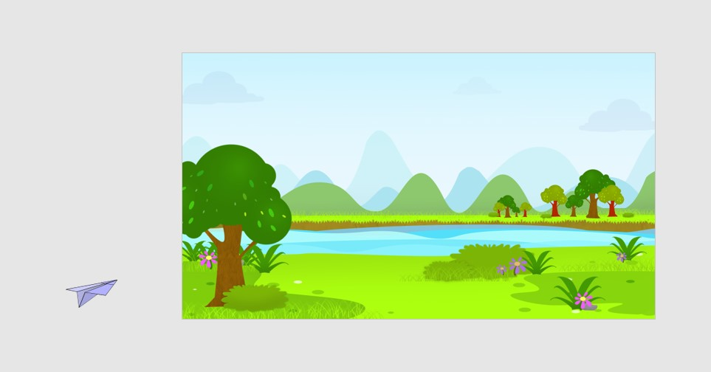
Flying a Paper Plane
Insert
png type
Image and drag
it
outside to
the slide
Notes:
Notes to presenter:
Description of what you learned in your own words on one side.
Include information about the topic
Details about the topic will also be helpful here.
Tell the story of your learning experience. Just like a story there should always be a beginning, middle and an end.
On the other side, you can add a graphic that provides evidence of what you learned.
Feel free to use more than one slide to reflect upon your process. It also helps to add some video of your process.

Slide 7
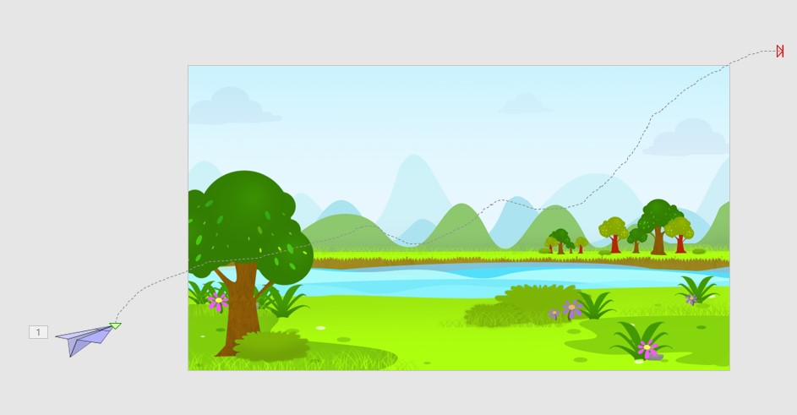
Flying a Paper Plane
Create custom
path for
movement
Notes:
Notes to presenter:
Description of what you learned in your own words on one side.
Include information about the topic
Details about the topic will also be helpful here.
Tell the story of your learning experience. Just like a story there should always be a beginning, middle and an end.
On the other side, you can add a graphic that provides evidence of what you learned.
Feel free to use more than one slide to reflect upon your process. It also helps to add some video of your process.

Slide 8
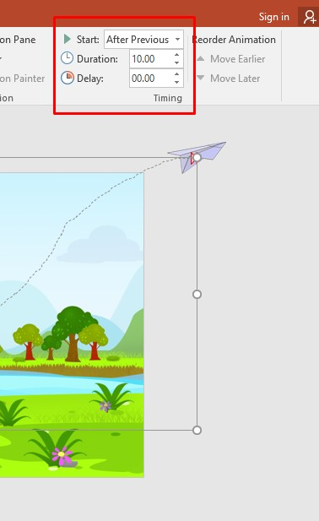
Flying a Paper Plane
Change the setting
To after previous
Then export the file
Notes:
Notes to presenter:
Description of what you learned in your own words on one side.
Include information about the topic
Details about the topic will also be helpful here.
Tell the story of your learning experience. Just like a story there should always be a beginning, middle and an end.
On the other side, you can add a graphic that provides evidence of what you learned.
Feel free to use more than one slide to reflect upon your process. It also helps to add some video of your process.

Slide 9

Our Animation (Click to play)

Slide 10


